Slide 1
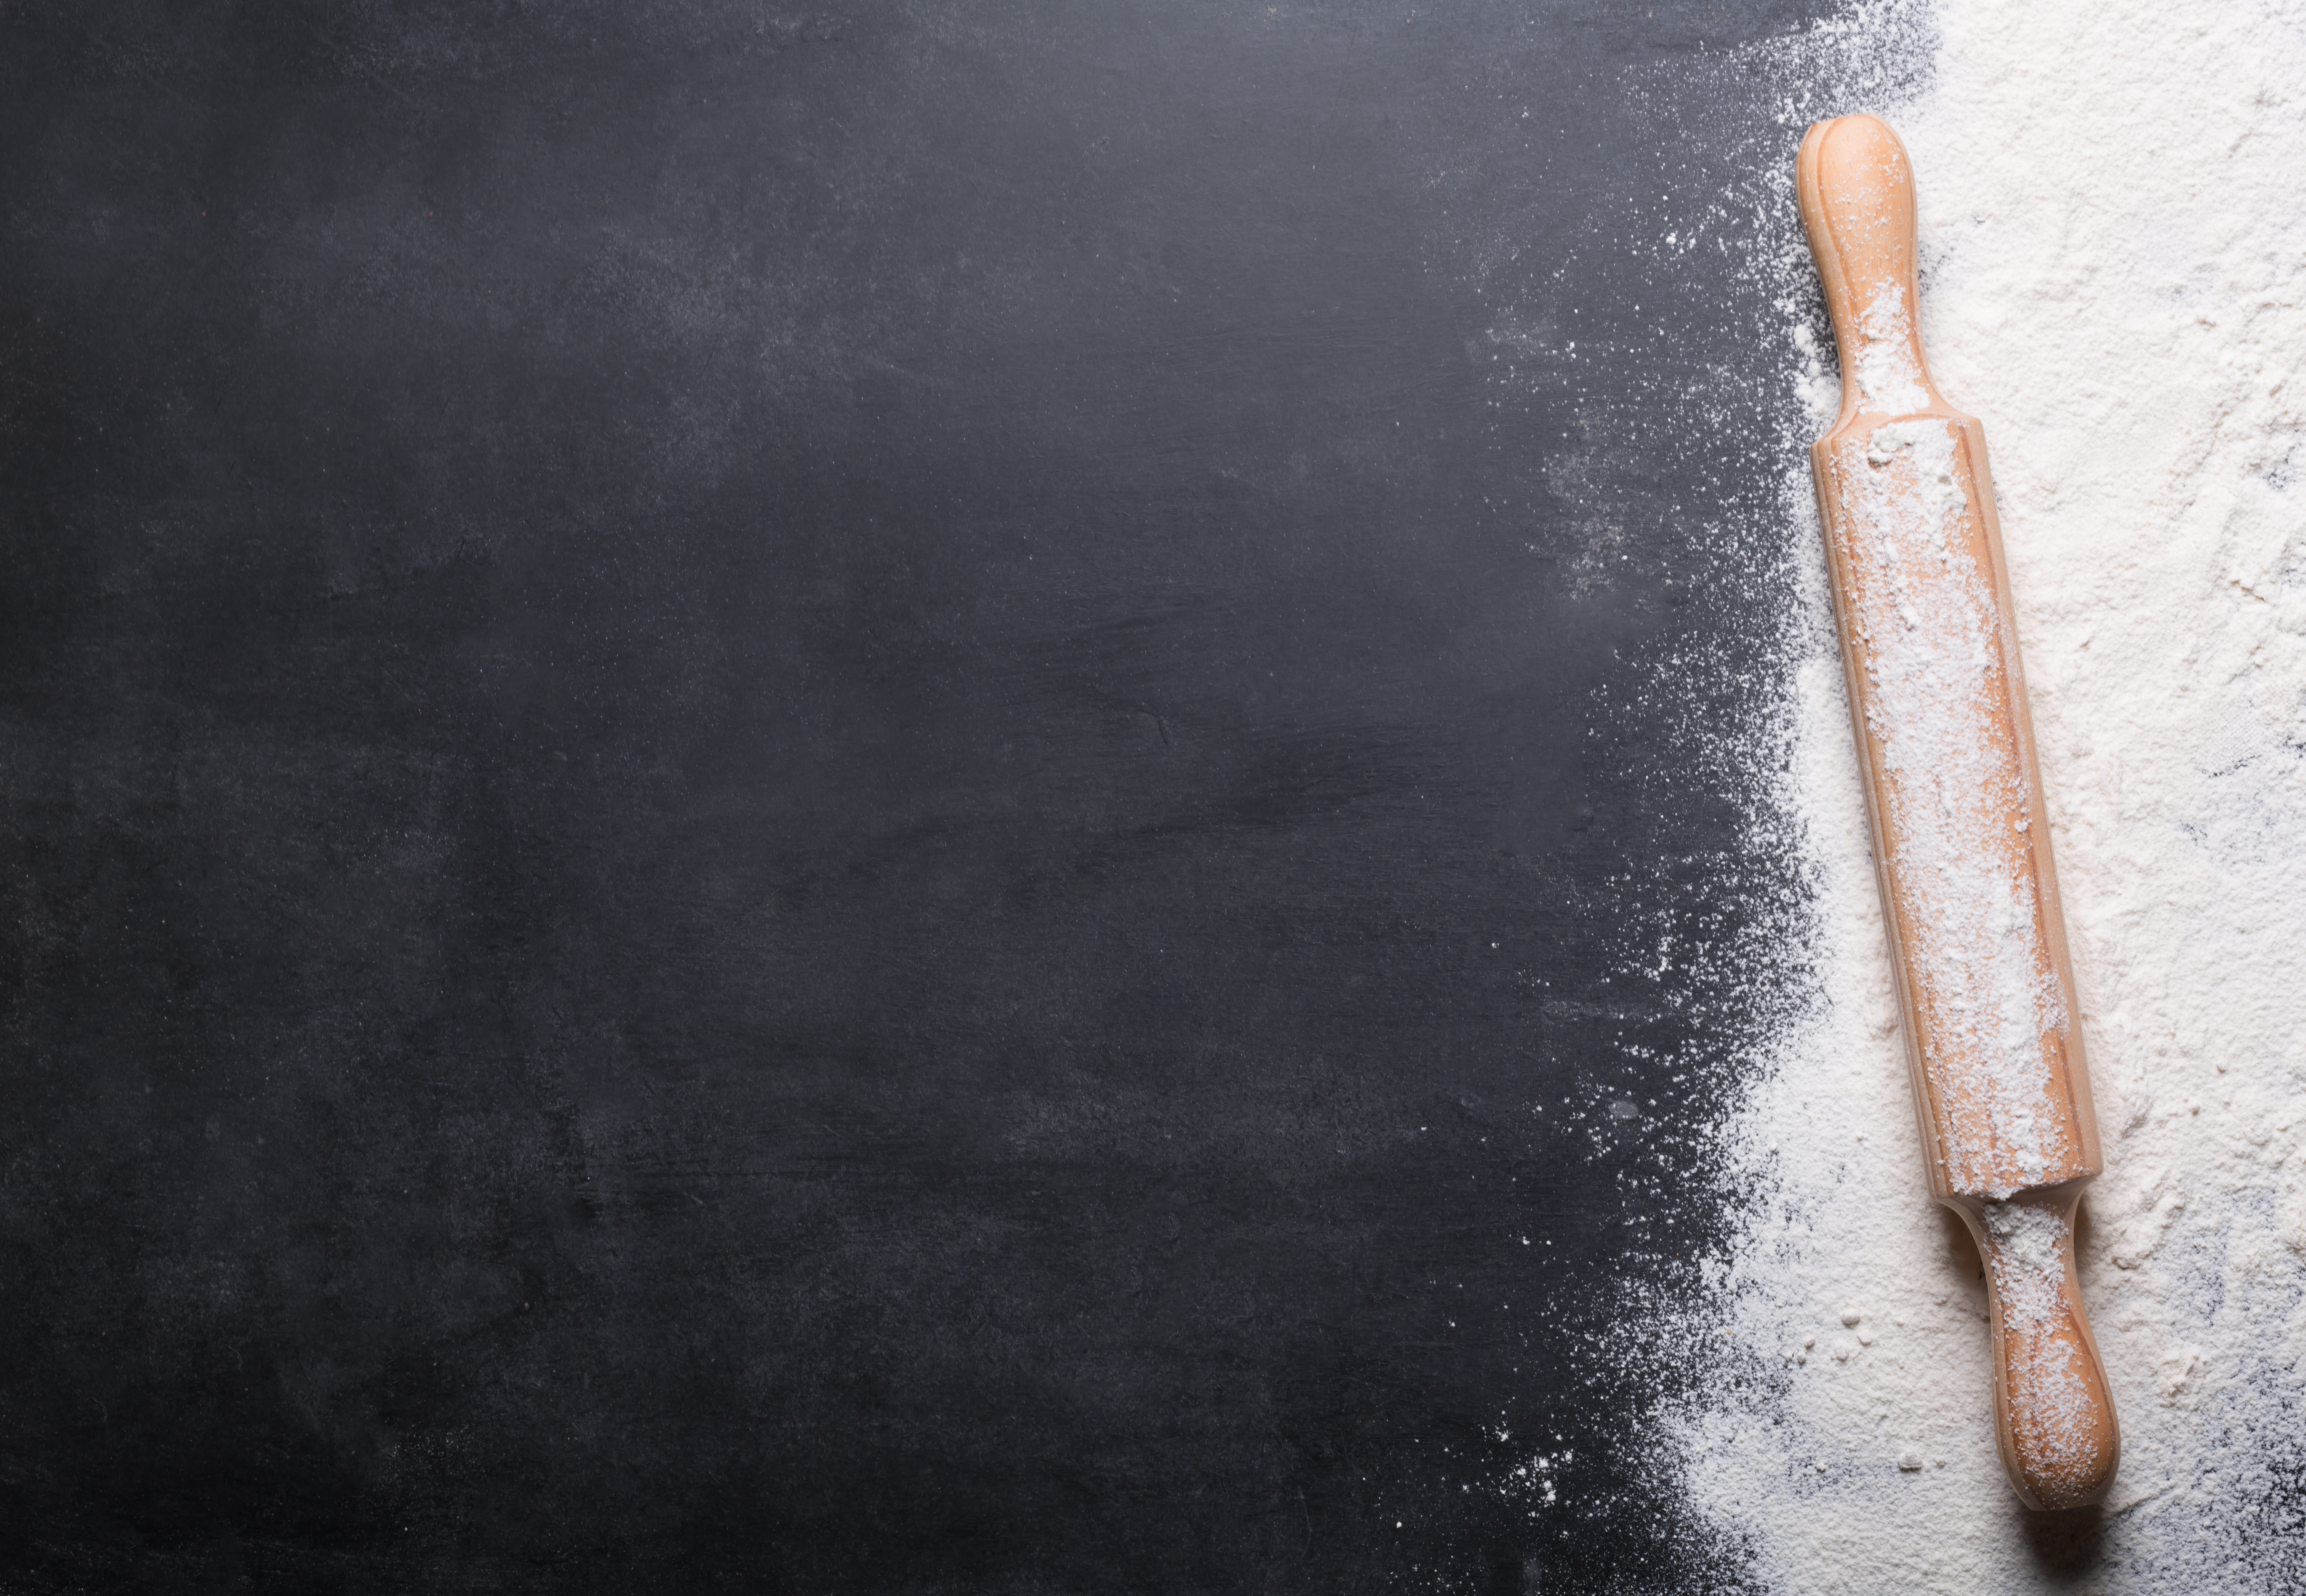
Header
Nav
Main Image |  |  | Main text/credit
 |  |  | Ingredients
 |  |  | Equipment
Directions Header
Step 1 | Step 2 | Step 3 | Step 4 | Step 5
Rate and Covert
Footer

Slide 2
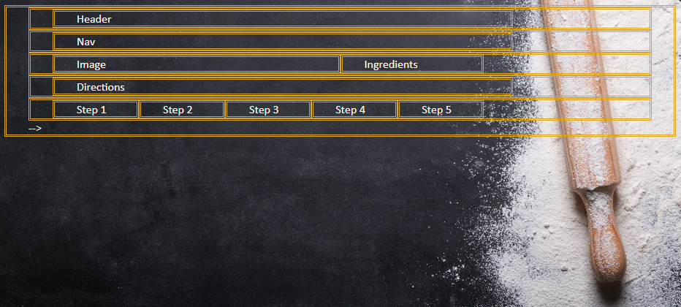
HTML boxes after organizing

Slide 3
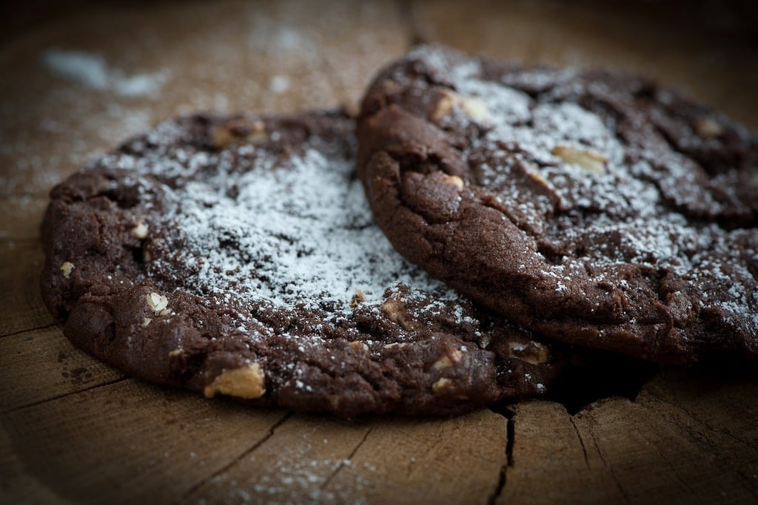
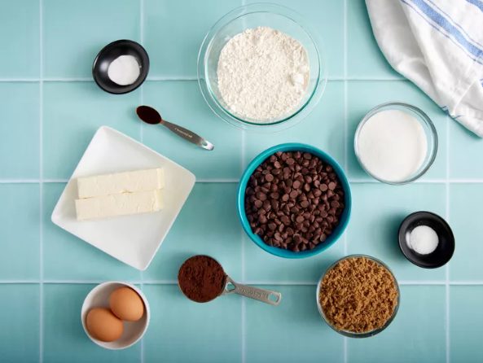
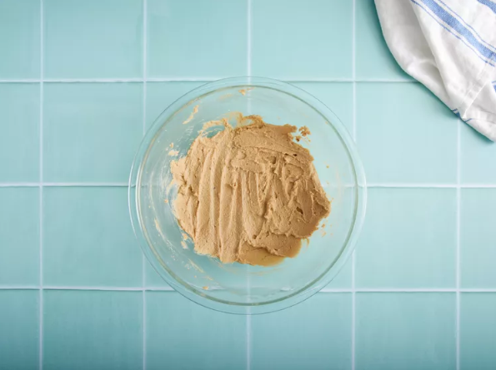
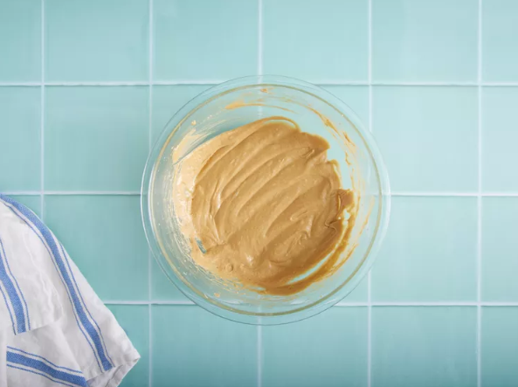
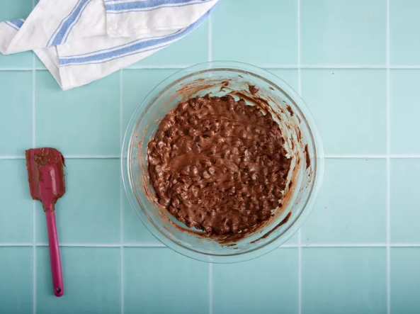
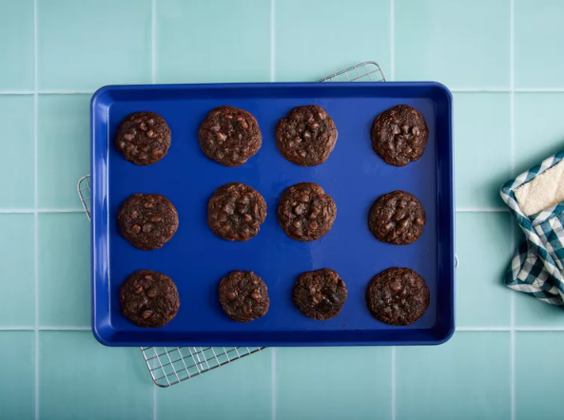
Header
Nav
Main Image |  |  | Main text/credit
 |  |  | Ingredients
 |  |  | Equipment
Directions Header
Step 1 | Step 2 | Step 3 | Step 4 | Step 5
Double Chocolate Chip Cookies
Double Chocolate Chip Cookies | Recipe 2 | Recipe 3 | Recipe 4
This recipe is adapted from allrecipes' Double Chocolate Chip Cookies from allrecipe Double Chocolate Chip Cookies Recipe
Ingredients
1 cup butter, softened
1 cup white sugar
1 cup brown sugar
2 eggs
1 teaspoon vanilla extract
2 cups all-purpose flour
1 teaspoon baking soda
1 teaspoon salt
⅓ cup unsweetened cocoa powder
3 cups semisweet chocolate chips
Equipment
Medium bowl
Cookie sheets
Wisk
Sifter
Measuring tools
Mixing Spoon
Photo by: Victoria Jempty, Allrecipes, from allrecipes photo of Double Chocolate Chip Cookies
Directions
Step 1 | Step 2 | Step 3 | Step 4 | Step 5
Gather all ingredients. Preheat the oven to 375 degrees F (190 degrees C). Grease cookie sheets. | In a medium bowl, cream together the margarine, white sugar, and brown sugar until smooth. Beat in the eggs one at a time, then stir in the vanilla. | Sift in the flour, baking soda, salt, and cocoa powder; mix well. Stir in the chocolate chips | Roll tablespoonfuls of cookie dough into balls and place them 1 inch apart onto the prepared cookie sheets. | Bake for 8 to 10 minutes in the preheated oven. Allow cookies to cool on baking sheet for 2 minutes before removing to a wire rack to cool completely.

